Slide 1
Module 2 – Leadership
Chapter 4 – How to Give Instruction
Section 1 – How to be an Effective Instructor

Slide 2
Demonstrate knowledge of the challenge of leadership, the qualities of an effective leader, how to evaluate the performance of subordinates and how to give instruction

Slide 3
Describe what learning theory is
List the major factors that influence learning
Describe the conditions that tend to hinder learning
Explain how to prepare a lesson plan, the site where instruction will occur, and yourself as the instructor

Slide 4
List the commonly used techniques for delivery of instruction
Describe the advantages and disadvantages of the lecture technique for presenting information

Slide 5


Key Term Questions Slide Index
Click any link below to go directly to polling that question.
Conceptual frameworks describing how information is absorbed
People trained to perform psychological research, testing, therapy
Period of little or no apparent progress in learning
Existing in thought but not having physical existence
Using negative attributes to motivate a person
Click here to return to this index.

Slide 6
Key Term Questions Slide Index
Click any link below to go directly to polling that question.
Use of words that mean opposite of what you really want to say
Brain hemisphere associated with creativity, music, expression
Brain hemisphere associated with analytical thinking, numbers, language
Instilling fear or threatening someone
Instructor's road map of what students need to learn
Click here to return to this index.

Slide 7
Team Assignment
Alpha
Bravo
Charlie
Delta

Slide 8
Conceptual frameworks describing how information is absorbed, processed, and retained during learning
Learning curve
Learning theory
Progressive curve
Progressive theory
1
1
1
1
(NS3-M2U1C4S1:KT1)

Slide 9
People trained and educated to perform psychological research, testing, and therapy
Psychotherapists
Psychoanalysts
Disorder analysts
Psychologists
1
1
1
1
(NS3-M2U1C4S1:KT2)

Slide 10
A period of little or no apparent progress in an individual's learning, reduced number of errors, etc., and indicated by a horizontal stretch in a learning curve or graph
Progression plateau
Learning stall
Learning plateau
Progressive stall
1
1
1
1
(NS3-M2U1C4S1:KT3)

Slide 11
Existing in thought or as an idea but not having a physical or concrete existence
Abstract
Philosophical
Factual
Nonconcrete
1
1
1
1
(NS3-M2U1C4S1:KT4)

Slide 12
Using negative attributes to motivate a person to achieve a desired result; using punishment as a consequence if a person does not achieve a good grade
Sarcasm
Affirmations
Negative motivation
Negative declarations
1
1
1
1
(NS3-M2U1C4S1:KT5)

Slide 13
Use of words that mean the opposite of what you really want to say to insult someone, to show irritation, or to be funny
Flattery
Sarcasm
Criticism
Banter
1
1
1
1
(NS3-M2U1C4S1:KT6)

Slide 14
The hemisphere of the brain believed to be associated with creativity, music, color, images, motion, expression
Creative cerebrum
Right brain
Left brain
Creative hemisphere
1
1
1
1
(NS3-M2U1C4S1:KT7)

Slide 15
The hemisphere of the brain believed to be associated with analytical thinking, decision making, numbers, language
Analytical cerebrum
Right brain
Left brain
Analytical hemisphere
1
1
1
1
(NS3-M2U1C4S1:KT8)

Slide 16
The act of instilling fear or threatening someone, usually in order to persuade the person to do something he or she does not wish to do
Demoralization
Persuasion
Compulsion
Intimidation
1
1
1
1
(NS3-M2U1C4S1:KT9)

Slide 17
The instructor’s road map of what students need to learn and how it will be done effectively during the class time
Lesson plan
Curriculum
Instructor's platform
Instructor's program
1
1
1
1
(NS3-M3U1C4S1:KT10)

Slide 18
Learning Theory -
Learning theories are conceptual frameworks describing how information is absorbed, processed, and retained during learning
Psychologists -
People trained and educated to perform psychological research, testing, and therapy

Slide 19
Learning Plateau -
A period of little or no apparent progress in an individual's learning, reduce number of errors, etc., and indicated by a horizontal stretch in a learning curve or graph
Abstract -
Existing in thought or as an idea but not having a physical or concrete existence

Slide 20
Negative Motivation -
Using negative attributes to motivate a person to achieve a desired result; using punishment as a consequence if a person does not achieve a good grade
Sarcasm -
Use of words that mean the opposite of what you really want to say to insult someone, show irritation, or to be funny

Slide 21
Right Brain -
The right hemisphere of the brain believed to be associated with creativity, music, color, images, motion, expression
Left Brain -
The left hemisphere of the brain believed to be associated with analytical thinking, decision-making, numbers, language

Slide 22
Intimidation -
The act instilling fear or threatening someone, usually in order to persuade the person to do something he or she does not wish to do
Lesson Plan-
The instructor’s road map of what students need to learn and how it will be done effectively during the class time

Slide 23

Name and describe different types of learning. What method of learning do you utilize?
1.
2.
3.
Note to Instructors:
Click the Show/Hide Response Display Button

Slide 24
Are you ready to learn today?
Distracted - It’s going to be a challenge.
Tired - I should’ve gotten more sleep.
Focused - I’m in a learning zone.
Energized - Teach me how to teach!
1
1
1
1
(NS3-M2U1C4S1:LQ1)

Slide 25
When a classroom and instructor are consistent, each student sees the classroom situation in the same manner.
True
False
(NS3-M2U1C4S1:LQ2)

Slide 26
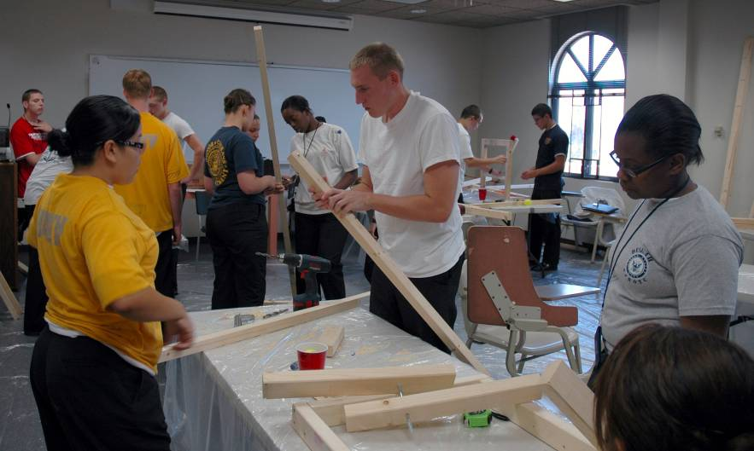
Introduction
Call to Instruction
You will often be called upon to deliver informal and formal instruction as you achieve higher rank.
To be and effective instructor, you must learn:
Learning theory
Preparation for instruction
Techniques for delivery

Slide 27
Learning Theory
Good Instructors are Skilled
A good instructor is a master of many skills.
A successful instructor demands competence in subject matter and knowledge of teaching skills.
Subject Matter Competence
+
Knowledge of Teaching Skills
=
Skilled Instructors

Slide 28

Learning Theory
Methods of Instruction
Methods of instruction depend a lot on an understanding of how people learn and the ability to apply that understanding.

Slide 29
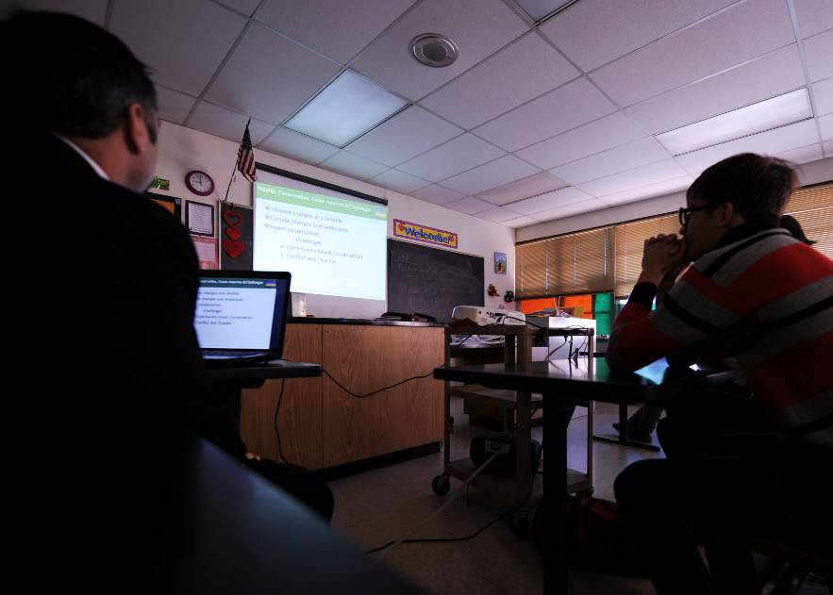
Learning Theory
Learning
Learning can be defined as a change in behavior as a result of experience.
The behavior can be physical and apparent, or it can be intellectual or attitudinal, not easily seen.

Slide 30
Learning Theory
Perceptions and Responses Differ
Each student sees the classroom situation differently. This is because:
He or she is a unique individual
Past experiences affect readiness to learn
Background affects understanding of the requirements involved
Responses differ because each person acts in accordance with how he or she sees each situation.

Slide 31

Learning Theory
Students ask, “What’s in it for me?”
Most people bring their ideas about what they want to do and achieve into the classroom.
What each student learns is affected by:
Each student’s individual needs
What the instructor is trying to get him or her to learn

Slide 32

Learning Theory
Students ask, “What’s in it for me?”
Effective instructors seek ways to relate new learning to each student’s personal goals.

Slide 33

Learning Theory
Learning from Experience
Learning is an individual process.
The instructor cannot learn or put knowledge into the student’s head.
Each student can learn only from that which is experienced.

Slide 34
Learning Theory
Psychological Classifications of Learning
Psychologists classify learning by types:
Conceptual
Verbal
Perceptual
Motor
Verbal
Conceptual
Perceptual
Motor
Problem solving
Emotional
Problem
Solving
Emotional

Slide 35

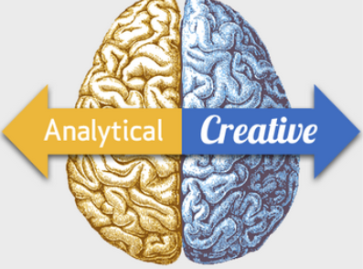
Learning Theory
Brain Stimulation
Research has shown that some types of learning appear to take place mainly on one side of the brain while others occur on the other side.
Both sides of the brain work together during learning, but most people have a dominant brain side.

Slide 36
Learning Theory
Brain Stimulation
Are you more left-brained or right-brained?
Left Side of the Brain
Numbers
Logic
Word puzzles
Analysis
Right Side of the Brain
Music
Imagination
Colors
Motion
Creative expression

Slide 37
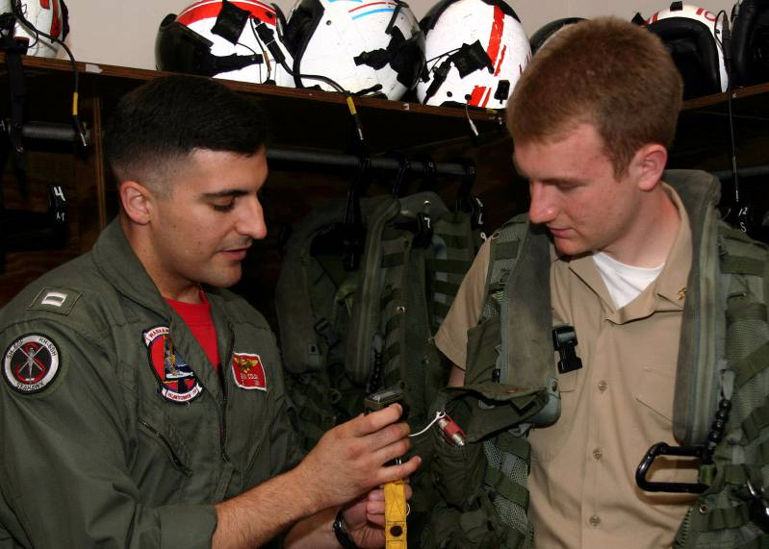
Learning Theory
Research Results
Much recent educational research has shown that the rate of learning can be greatly increased when instructors involve both sides of the brain in their teaching strategies.

Slide 38
Learning Theory
Learning Plateau
Graphs of the progress of learning follow the same pattern.
As the number of trials increases, the number of errors decreases rapidly, until a learning plateau is reached, after which further improvement comes slowly.

Slide 39
Learning Theory
Point of Plateau
Reaching a learning plateau or point of plateau signifies the learner may have:
Reached the limits of his or her capability
Consolidated the level of skill
Lost a measure of interest
Need for a different method

Slide 40

Learning Theory
Point of Plateau
Even so, apparent lack of progress does not mean further learning is impossible.

Slide 41

Learning Theory
Reducing Frustration and Discouragement
Explain to the learner that a leveling (plateau) process is normal, especially when learning motor skills, and should be expected after an initial period of rapid improvement.

Slide 42

Learning Theory
Getting Students Ready to Learn
Learners progress more when motivated by:
A strong purpose
A clear objective
A well-defined reason
A student that is ready to learn meets the instructor at least half-way which simplifies the instructor’s job.

Slide 43
Learning Theory
Speeding, Strengthening, Enhancing Learning
Attach new learning to areas of existing knowledge so the learner will progress from:
Known to unknown
Concrete to abstract
Ensure pleasant or satisfying feelings instead of unpleasant feelings such as:
Defeat, Frustration
Anger
Confusion, Futility

Slide 44
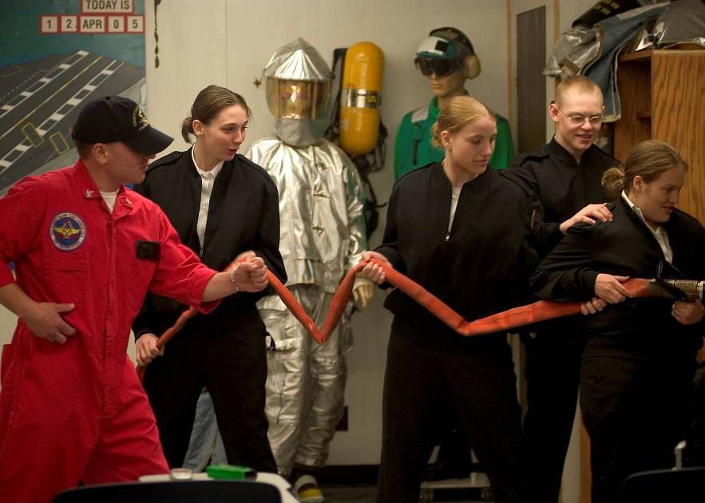
Learning Theory
Negative Motivation Caution
Avoid presenting problems that are impossible to solve or beyond the learner’s capability to understand and solve.
The student’s chance of success is increased if the learning experience is pleasant.

Slide 45

Learning Theory
Identify and Satisfy the Need
The instructor’s responsibility is first to recognize and identify the needs in students, and then to seek ways of satisfying the needs through teaching.
The learning situation should contain at least some things that affect the student positively and give him/her a feeling of satisfaction.

Slide 46
Learning Theory
Identify and Satisfy the Need
What will make the learner move toward a goal?
Is it a need for:
Security?
Self-esteem?
Belonging?
Helping others?

Slide 47
According to recent research, what will the result be if the instructor tries to incorporate both sides of the learner’s brain?
Rate of learning will decrease.
Rate of learning will increase.
The learning plateau will be increased.
The learning plateau will be eliminated.
1
1
1
1
(NS3-M2U1C4S1:LQ3)

Slide 48
Initial learning may come quickly until a plateau is hit and the rate of learning decreases. This is especially true of which classification of learning?
Verbal
Conceptual
Perceptual
Motor
1
1
1
1
(NS3-M2U1C4S1:LQ4)

Slide 49
Learning Theory
Nine Major Factors that Influence Learning
There are nine major factors that influence learning:
1. New learning takes place in the context of past
personal experience.
2. Learning is dependent upon motivation.
3. Learning is reinforced through personal exercise.

Slide 50

Learning Theory
Nine Major Factors that Influence Learning
Learning is facilitated by linking with prior
knowledge.
Learning is more efficient when new information
is logically related.

Slide 51
Learning Theory
Nine Major Factors that Influence Learning
6. Learning is enhanced by providing time for
reflection.
7. Learning is enhanced by sensory and emotional
involvement.
8. Learning occurs best in an environment that
enables more than one kind of learning.
9. Learning requires repetition.

Slide 52
Interpersonal Interactions
Instructor-Student Interactions
Learners must feel secure, accepted, and capable of success for them to:
    Pay attention
    Actively participate
    Participate responsibly

Slide 53
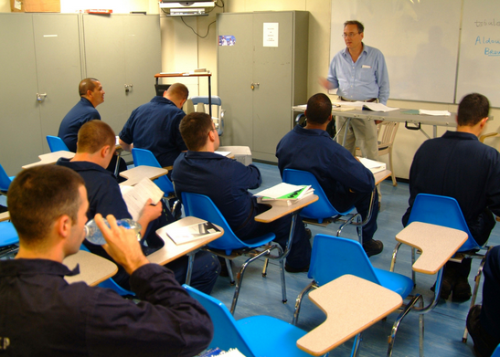
Interpersonal Interactions
Instructor-Student Interactions
Creating a positive learning environment is the instructor’s responsibility.
Instructor-student interactions can either improve or hinder learning.

Slide 54
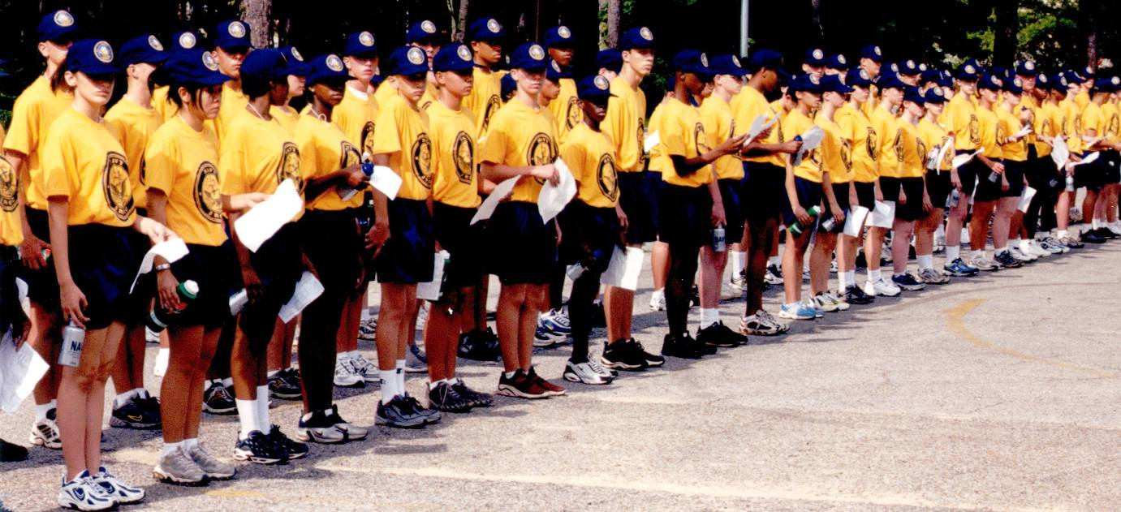
Interpersonal Interactions
Conditions that Hinder Learning
Some of the conditions that hinder learning are:
Destructive sarcasm
Intimidation
Boredom
Frustration
Fatigue
Lack of purpose
Sense of failure

Slide 55
Interpersonal Interactions
Error and Failure Differ
Instructors must understand and appreciate the fact that every classroom interaction is a potential teachable moment, which includes learning from errors.
Errors can help students learn, but failures cannot.

Slide 56
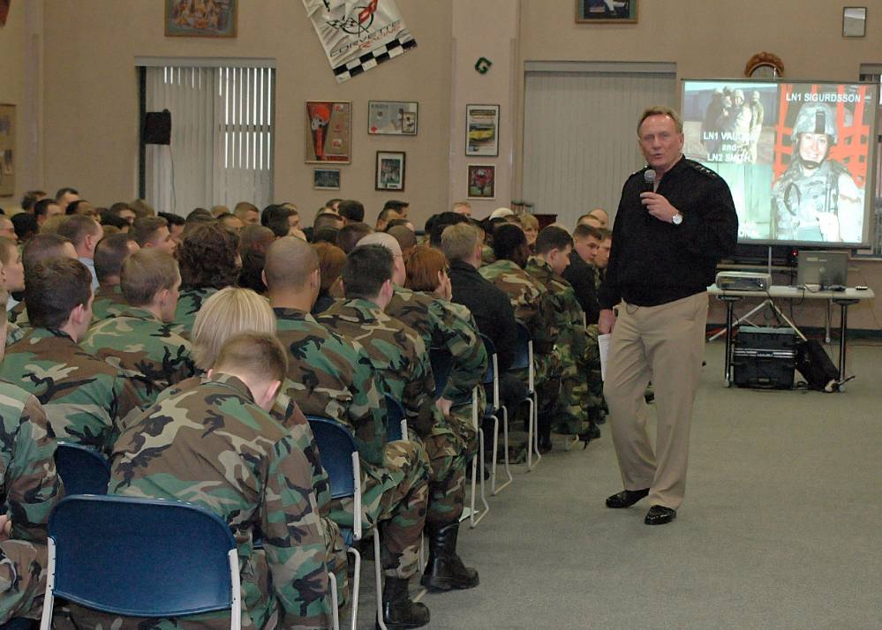
Preparation for Instruction
Prepare for Presentation
Every instructor, no matter how competent or experienced, needs to prepare before giving a presentation.
Adequate preparation is a must for efficient and effective instruction.

Slide 57

Preparation for Instruction
Create or Review the Lesson Plan
Creating a lesson plan is the first step to preparing to instruct.
If the lesson has already been planned, the instructor need only become familiar with the plan, and perhaps personalize it.

Slide 58
Preparation for Instruction
Format of a Lesson Plan
(Part 1 of 2)
For every lesson plan, ask yourself the following questions:
  What is the intended objective or outcome?
  Who is the intended audience?
  What training aids/equipment are needed?
  What technique for instruction will be used?

Slide 59

Preparation for Instruction
Format of a Lesson Plan
(Part 2 of 2)
Is the outline of material to be presented detailed enough?
What means will be used to assess the effectiveness of the instruction?
Has a closing or summary been prepared?

Slide 60
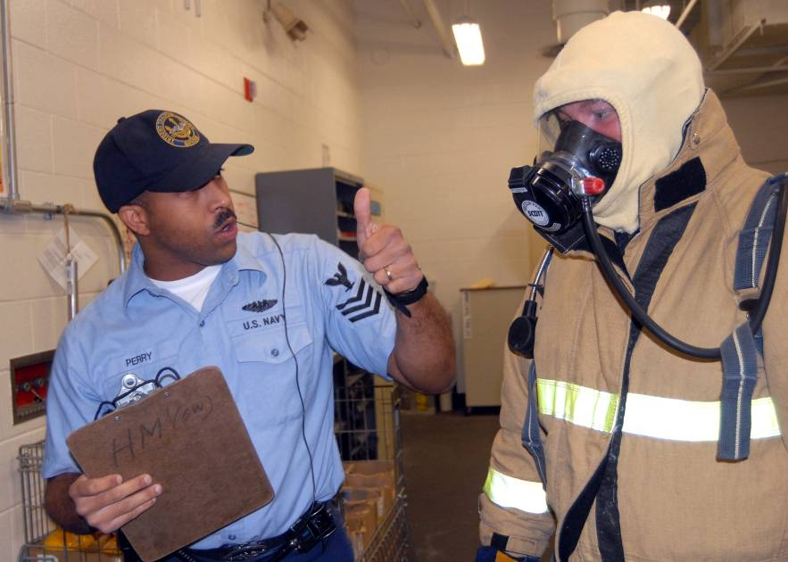
Preparation for Instruction
Site Preparation: Create a Checklist
Prepare a checklist of needs based on the type of instruction and the type of environment in which the instruction will occur.

Slide 61
Preparation for Instruction
Example: Classroom Instruction
During preparation to teach in any given classroom, ask yourself the following questions:
Is there enough seating, desks, and tables?
Is there adequate lighting, ventilation, heating/cooling, electric power?
Is there adequate demonstration/board space and markers/chalk/erasers?

Slide 62
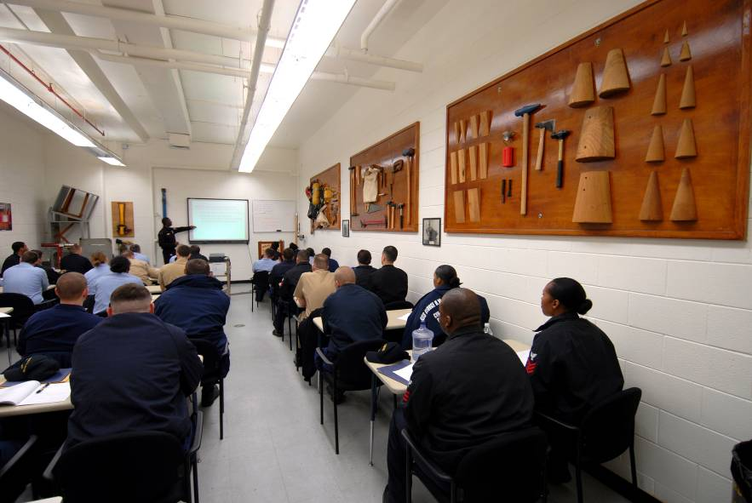
Preparation for Instruction
Example: Classroom Instruction
Audiovisual equipment prepared and functional?
Enough instructional materials such as book and handouts?
Enough equipment, hardware, computers on hand?

Slide 63

Preparation for Instruction
Are you Personally Prepared?
Become personally prepared to teach by doing the following:
Rehearse:
  Delivery
  Chalkboard work
  Equipment handling

Slide 64
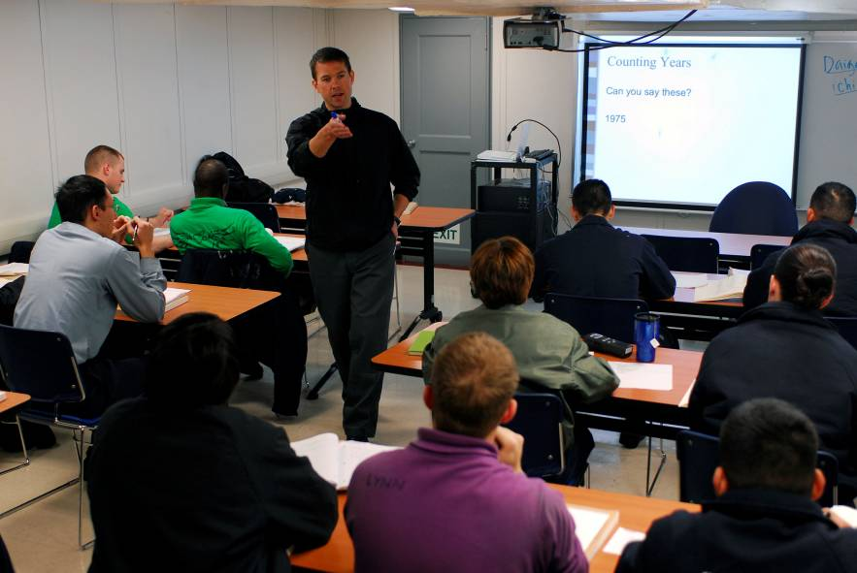
Preparation for Instruction
Are you Personally Prepared?
Review the names of students
Prepare your personal appearance including your:
  Hair
  Clothing or uniform
  Shoes

Slide 65
The old practice of having the student write a new spelling word is using which factor that influences learning?
Motivation
Reflection
Repetition
Emotional involvement
1
1
1
1
(NS3-M2U1C4S1:LQ5)

Slide 66
Which of the following conditions that hinder learning in the classroom can the student control?
Intimidation
Fatigue
Poor lighting
Destructive sarcasm
1
1
1
1
(NS3-M2U1C4S1:LQ6)

Slide 67

Techniques for Instruction
One Size Does Not Fit All
No one instructional technique is perfect for all occasions.
Fit the technique to the:
Type of material
Objective of instruction
Nature of the students
Your experience and personality

Slide 68
Techniques for Instruction
Main Methods of Instruction
Here is a list of the main methods of instruction:
Lecture
Lecture with audiovisual aids
Demonstration
Role playing
Case study
Discussion
Cooperative learning
For each method of instruction there are advantages, disadvantages and prescribed methods.

Slide 69

Techniques for Instruction
Lecture
A lecture is a presentation of information, concepts, or principles by a single individual to a group of listeners.
It is one-way communication.

Slide 70
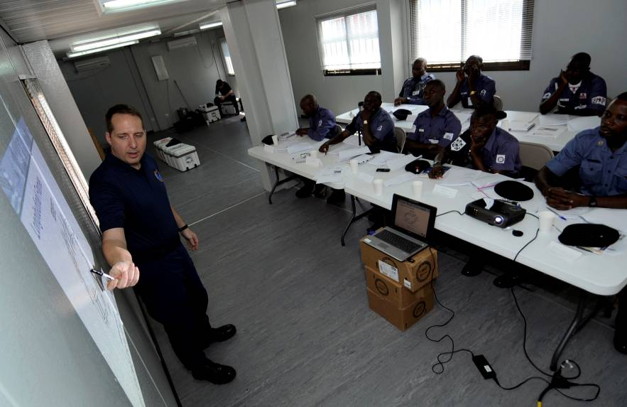
Techniques for Instruction
Lecture Assumptions
Application of the lecture method involves the following assumptions:
Instructor knows all
Students are ignorant about the subject matter
During the lecture, students have little opportunity to ask questions or make comments

Slide 71
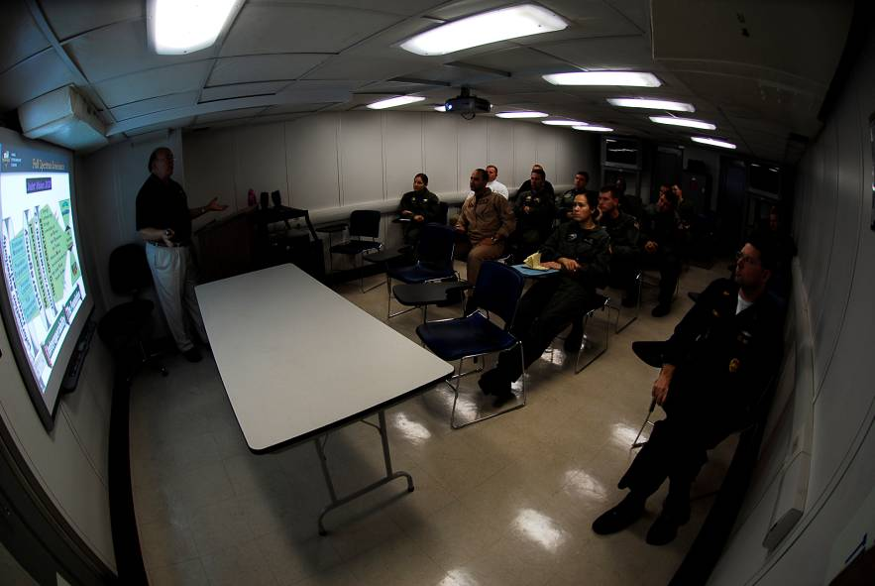
Techniques for Instruction
Lecture Advantages
The lecture method is the most efficient instructional method for presenting many facts or ideas in a relatively short period of time.

Slide 72
Techniques for Instruction
Lecture Advantages
Lectures are especially good for:
Introducing a subject
Ensuring all have the necessary background information
Giving direction and purpose to a demonstration
Preparing students for discussion
Delivering information when there are many students

Slide 73

Techniques for Instruction
Lecture Usefulness
Lecture is often useful to supplement, summarize, and/or emphasize material from other sources or information difficult to obtain in other ways.
It is good for when students do not have time for research and/or do not have access to reference material.

Slide 74
Techniques for Instruction
Lecture Disadvantages
There are disadvantages to use of the lecture method, including...
Too many lectures or long lectures without questioning students can cause boredom
Lectures promote student passiveness
Possibility of restating or repeating what the learner already knows from reading a textbook

Slide 75
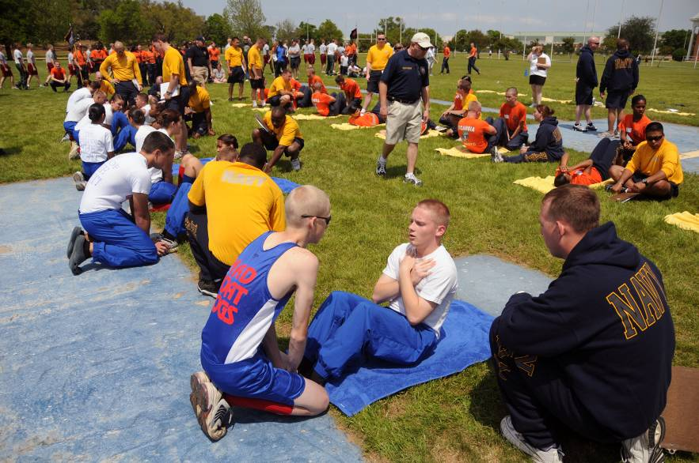
Techniques for Instruction
Lecture Disadvantages
Lecture is not suited to certain types of learning such as:
Speech skills
Cooperative group thinking
Motor skills
Complex concepts and principles

Slide 76

Techniques for Instruction
Lecture Disadvantages
Difficult for the instructor to judge how well the audience is reacting and if the students’ needs and interests are being met
An assumption is that the learners are taking adequate notes and are actively listening

Slide 77
Discuss what makes a positive and productive learning environment or situation.
1.
2.
3.
Note to Instructors:
Click the Show/Hide Response Display Button

Slide 78
Lectures oftentimes have a negative connotation, but when are they most efficient?
When the students are knowledgeable about the subject matter
When a discussion will be involved
When working with small groups
When presenting many facts or ideas in a short period of time
1
1
1
1
(NS3-M2U1C4S1:LQ7)

Slide 79
The instructor wants to present a lesson in which the students would work together to design a new type of ship. Instead of a lecture, what method of instruction could she use?
Lecture with audiovisual aids
Demonstration
Role playing
Cooperative learning
1
1
1
1
(NS3-M2U1C4S1:LQ8)

Slide 80
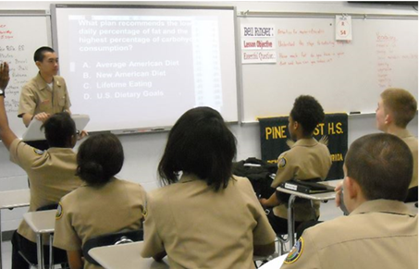

Slide 81
Leaderboard
Last
Slide
Points | Participant | Points | Participant

Slide 82
Team Scores
Last
Slide
Points | Team | Points | Team

Slide 83
Team MVP
Last
Slide
Points | Team | Participant

Slide 84
Whiteboard
Last
Slide

